Slide 1


Midterm Presentation
Karina Huang, Dianne Lee, Abhimanyu Vasishth, Phoebe Wong

Slide 2
About the Partner
AP is a cooperative, not-for-profit news agency that serves news in over 100 countries
Cooperative: member news organizations grant permission for the AP to distribute their local news reports
Non-member newspapers subscribe to AP and pay a fee to AP to get their material published
Independent editors and publishers also pay for licensed AP content (such as images, videos and audio files)
Source: https://www.ap.org/about/annual-report/2016/ap-by-the-numbers.html

Slide 3
Problem Statement
One of the main sources of revenue for AP is the sale of image licenses to publishers who use these images in their articles
Publishers currently search text associated with the images they are looking for through manually generated keywords, which is time consuming and may not make full use of the wide range of images at AP’s disposal.
Instead, we build an image recommendation system that takes in article text and outputs a set of images.
This could be used on the AP web portals or in an API for external clients

Slide 4
Motivation
AP Perspective: Efficient, automatic interface for internal and external clients to generate quicker & more fitting images
NLP Perspective: Model the way a client would think about this problem through creative combination of NLP techniques, e.g. entity extraction to sentiment analysis, with a flavor of computer vision
Challenges
What defines the “best” image recommendation?
Potential Issues
Don’t have access to entire image corpus, only those associated with existing articles
Exploring article-image relationships other than tag-to-tag matching, e.g. NN approaches

Slide 5
Project Plan: Scope of Work
Recommendation Engine
Uses and ranks article tags
Uses image captions and metadata: recency, other optional user-defined parameters
Determines image scoring/ranking system
Nice-to-have: image sentiment analysis
AP’s Tagging API (text -> tag)
Images
[id: ‘im392’, score: 0.9322,
id: ‘im322’, score: 0.9219,
……..
id: ‘im100’, score: 0.8321,
id: ‘im021’, score: 0.7911]
Article text
…………………………
(uploaded by user)
Our tagging model
(e.g. using textacy named-entity extraction)
Displayed on a UI that can also be used for testing & showing results
Wrapped in an API endpoint

Slide 6
Literature Review
Keyword ranking
TextRank, PageRank
Theme-weighted Ranking of Keywords from Text Documents using Phrase Embeddings
Image-Sentence Retrieval
Bidirectional Image-Sentence Mapping
Learning Two-Branch NN for Image-Text Matching Tasks
Overview of Text Similarity Metrics
Notes:
https://towardsdatascience.com/textrank-for-keyword-extraction-by-python-c0bae21bcec0
tf-idf

Slide 7
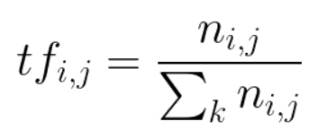
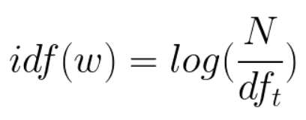
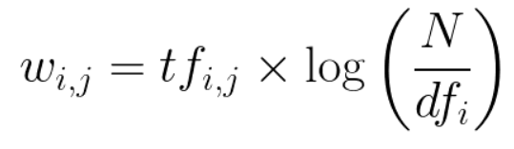
Literature Review
Using TF-IDF to Determine Word Relevance in Document Queries (Ramos 2003)
Results of applying Term Frequency Inverse Document Frequency (TF-IDF) to determine favorable words in a corpus of documents to use in a query
(1) Term Frequency
(2) Inverse Document Frequency
Notes:
tf-idf

Slide 8
Literature Review - TextRank
TextRank (Mihalcea, R., & Tarau, P. (2004))
A graph-based ranking model, rank extracted keywords with “importance”
Inspired by Google’s PageRank to rank web pages
Extract keywords from full text
Ranking keywords
Each keyword is a node and weight decided by the weights of its associated keywords
Example: for an article,
Keyword list: [w1, w2, …, w_n]
Select a k window of keywords: [w1, w2, …, w_k] (k: {2-10})
Any 2-word pair = 1 undirected edge (w1w2, w1w3, …, w1w_k, w2w3...)
Notes:
TextRank
Mihalcea, R., & Tarau, P. (2004). Textrank: Bringing order into text. In Proceedings of the 2004 conference on empirical methods in natural language processing (pp. 404-411).

Slide 9
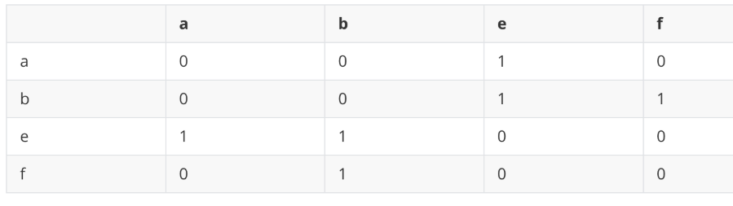
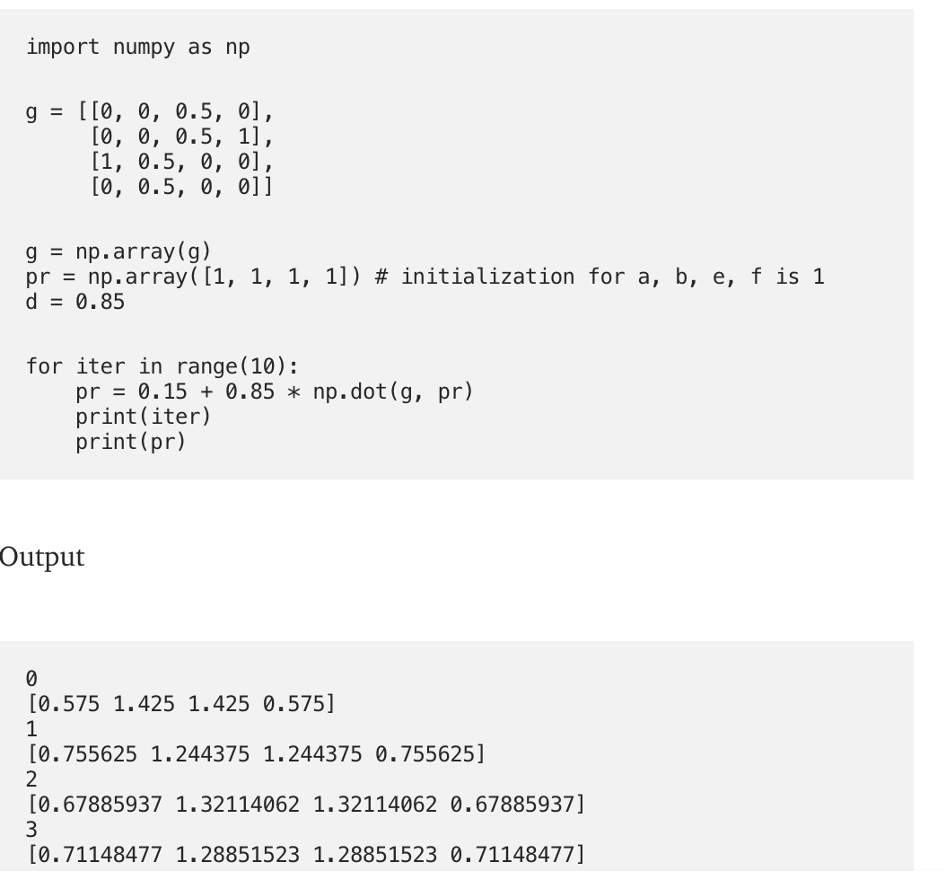
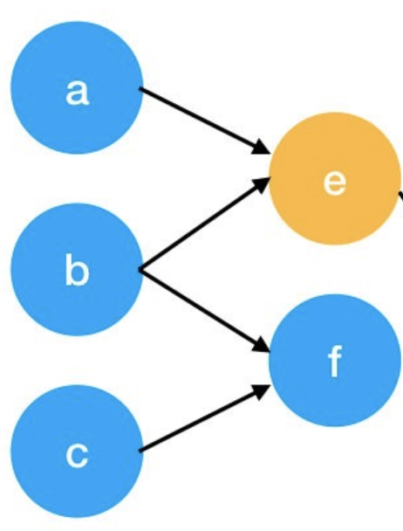
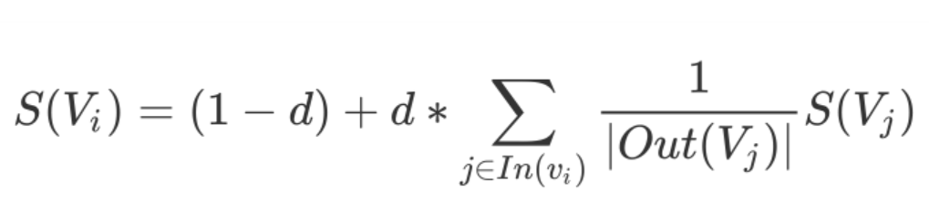
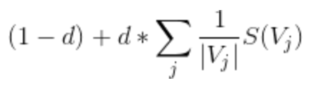
Literature Review - TextRank
Notes:
Weight of each keyword = S(V_i)
D = damping factor between 0 to 1
Then normalize columns
Break when the update difference is minimal

Slide 10
Literature Review - TextRank
Parameter Suggestion from Literature
Converges usually for 20-30 iterations, at a threshold of .0001
N-gram (for example, combine neighboring keywords to be n-gram keywords)
“Matlab code for plotting ambiguity functions” with keywords {‘Matlab’, ‘code’}
Then combine ‘Matlab code’ to be one keyword
Extract T keywords from final ranked keywords (5-20 or ⅓ * size of text)
Can potentially combine with named entities recognition
e.g., only consider scores of named entities
Notes:
Weight of each keyword = S(V_i)
D = damping factor between 0 to 1
Then normalize columns

Slide 11
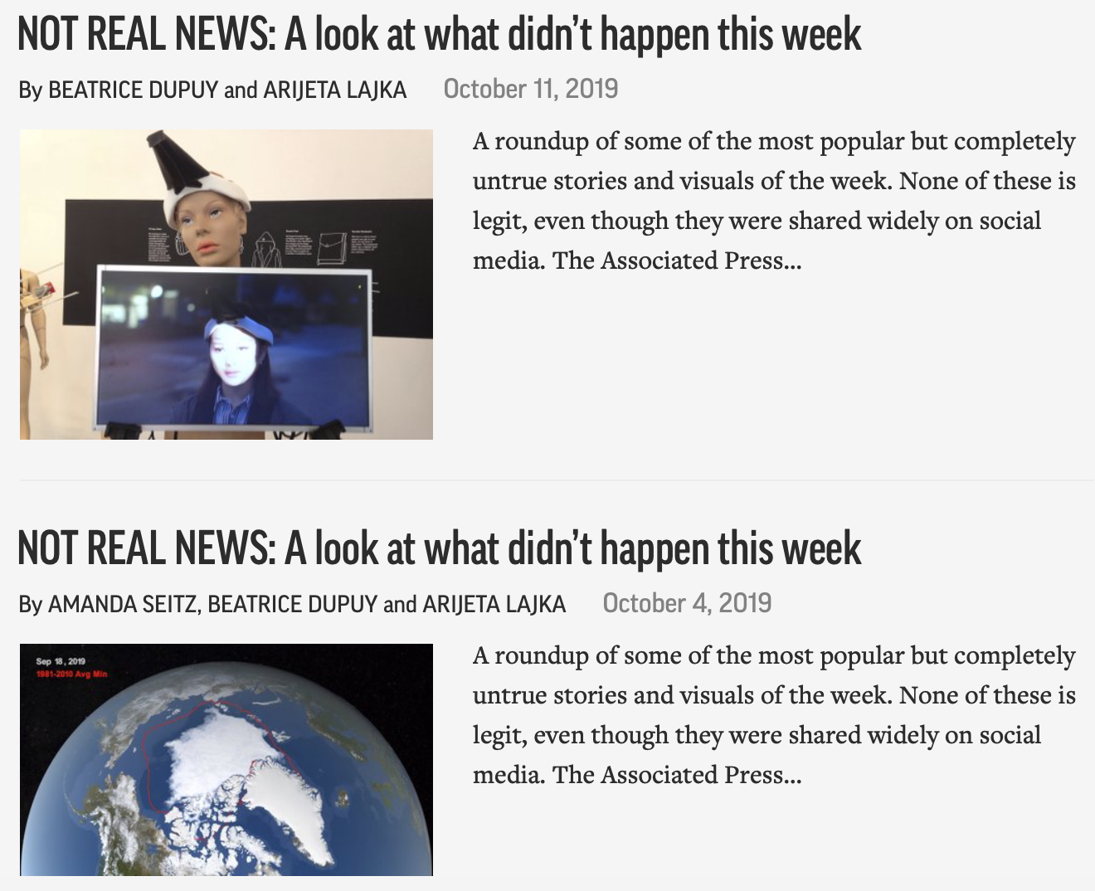
Literature Review - Next Steps
Relevance Ranking
DeepRank¹
Tag Importance Ranking + Multimodal Image Retrieval²
Sentiment Analysis
Sentiment analysis for news³
Image sentiment analysis with deep networks⁴
Notes:
¹Pang, L., Lan, Y., Guo, J., Xu, J., Xu, J., & Cheng, X. (2017, November). Deeprank: A new deep architecture for relevance ranking in information retrieval. In Proceedings of the 2017 ACM on Conference on Information and Knowledge Management (pp. 257-266). ACM.
²Li, S., Purushotham, S., Chen, C., Ren, Y., & Kuo, C. C. J. (2017). Measuring and predicting tag importance for image retrieval. IEEE transactions on pattern analysis and machine intelligence, 39(12), 2423-2436.
³Godbole, N., Srinivasaiah, M., & Skiena, S. (2007). Large-Scale Sentiment Analysis for News and Blogs. Icwsm, 7(21), 219-222.
⁴You, Q., Luo, J., Jin, H., & Yang, J. (2015, February). Robust image sentiment analysis using progressively trained and domain transferred deep networks. In Twenty-ninth AAAI conference on artificial intelligence.

Slide 12
Data Extraction
Media API (On-demand queue)
media_api.py
Article 1
Entities: [Person, Subject, Event, Organization]
Headline, Full Text
URL, Keywords
Article 2
Entities: [Person, Subject, Event, Organization]
Headline, Full Text
URL, Keywords
Article N
Entities: [Person, Subject, Event, Organization]
Headline, Full Text
URL, Keywords
....
article_item.py
Image 1
Entities: [Person, Subject, Event, Organization]
Caption, URL
Thumbnail, Full Size Image
Image K
Entities: [Person, Subject, Event, Organization]
Caption, URL
Thumbnail, Full Size Image
image_item.py
api_main.py
....
FIle that actually instantiates the classes and makes the API calls
Image File
Image File

Slide 13
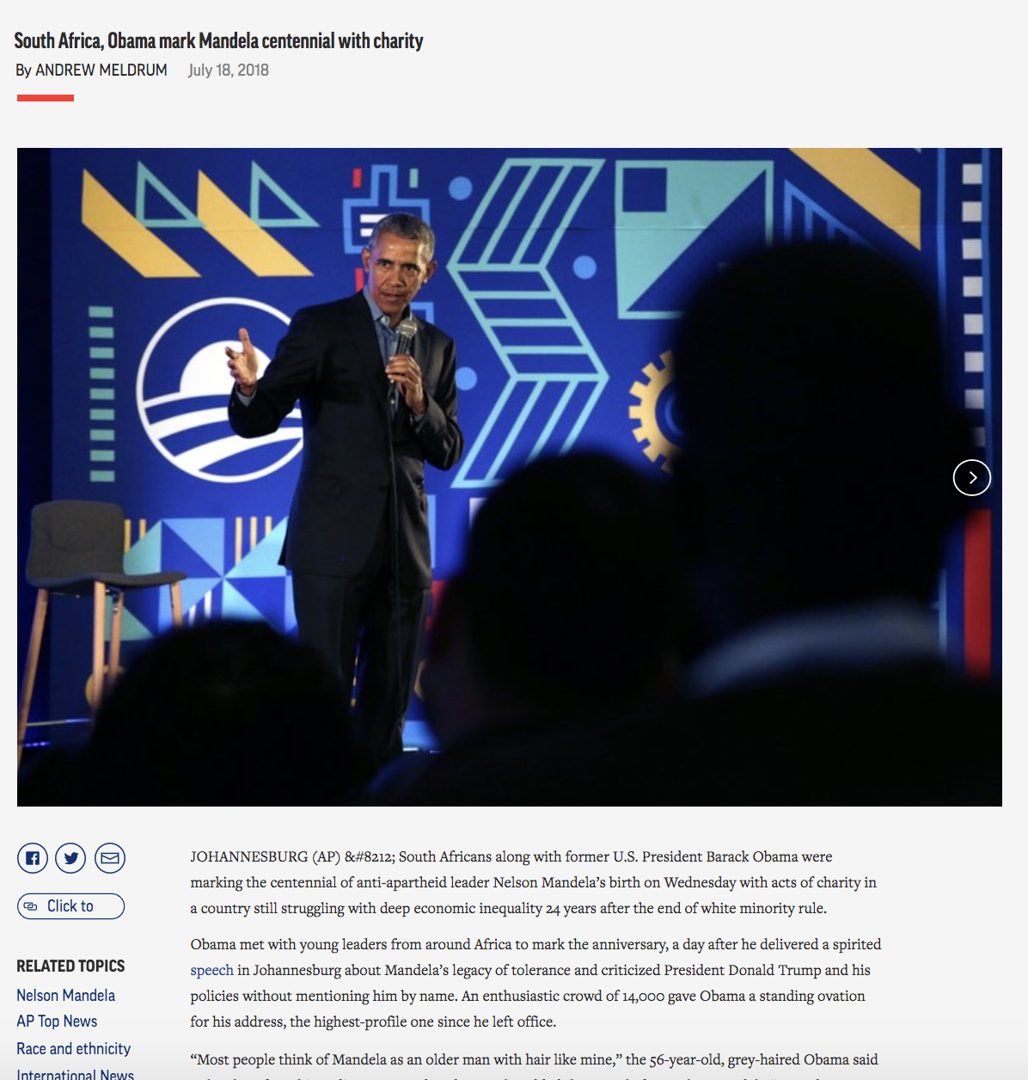
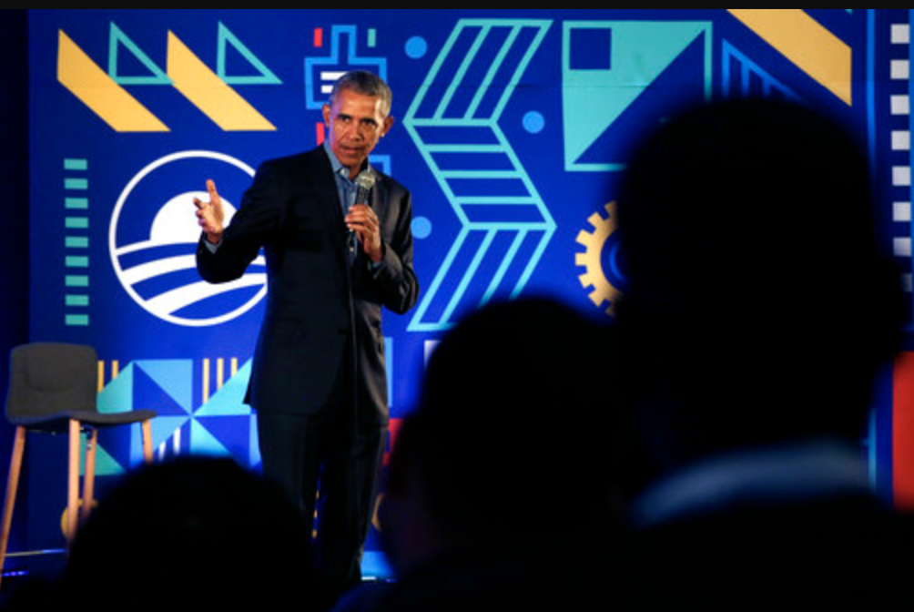
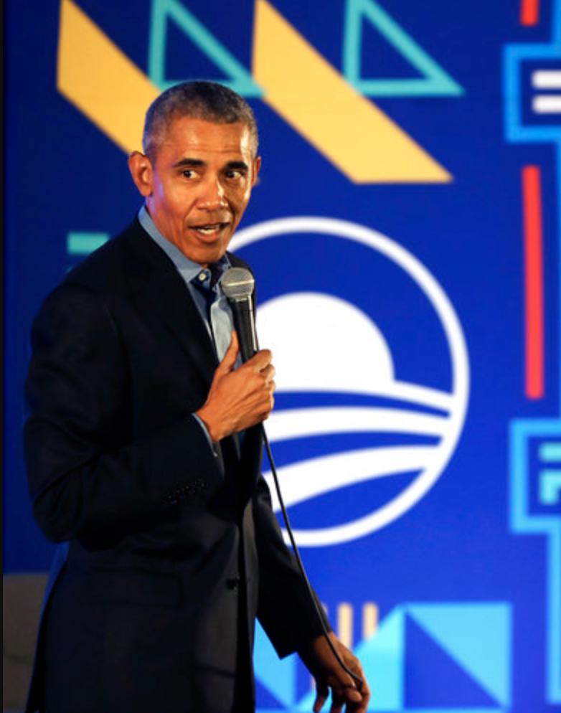
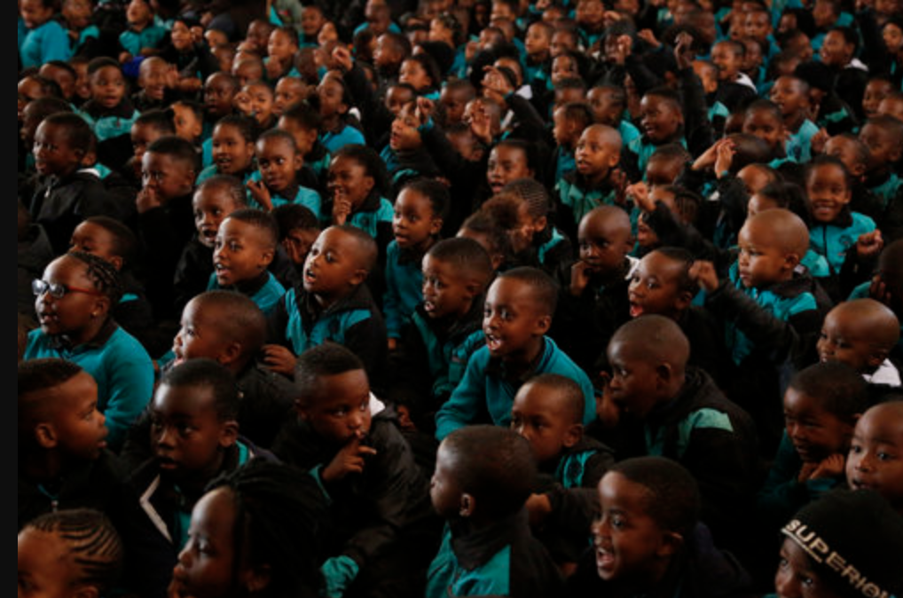
EDA: Example
Person
Barack Obama, Antonio Gutierres, Beyonce Knowles, Nelson Mandela
Subject
General News, Government and Politics, Race and Ethnicity, Social Issues, African Americans
Organisation
South Africa Government
Place
United States, South Africa, Southern Africa
Article
Tags
Associations

Slide 14
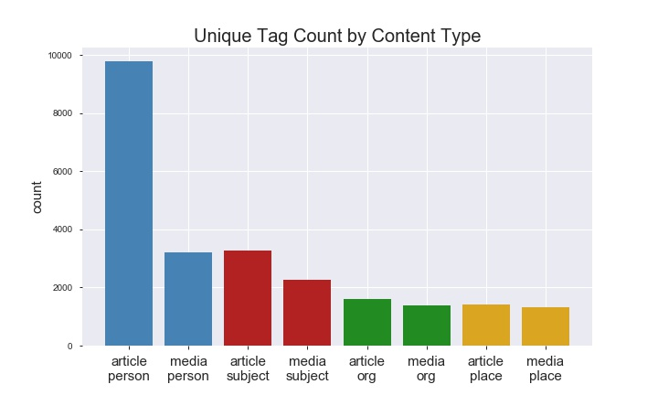
EDA: Metadata Summary
Available Data
30,098 articles
Created from Feb-Sep 2019
99.9% in English
81,126 media files
96.8% images
Maximum number of media file per article: 67
7,348 articles without media files

Slide 15
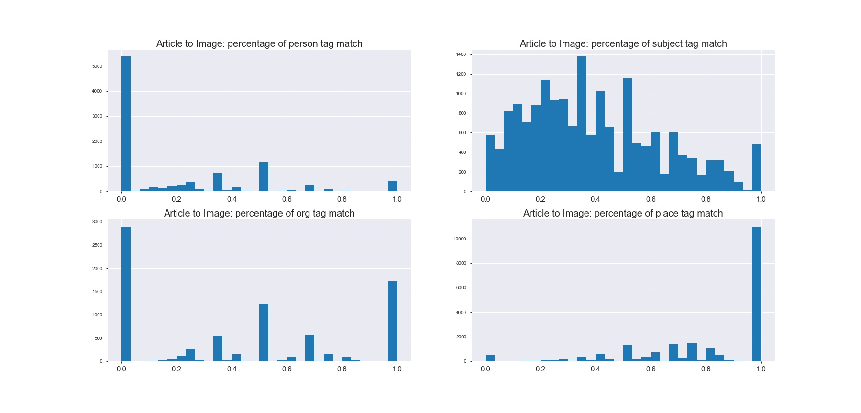
EDA: Article to Image Tag Matching

Slide 16
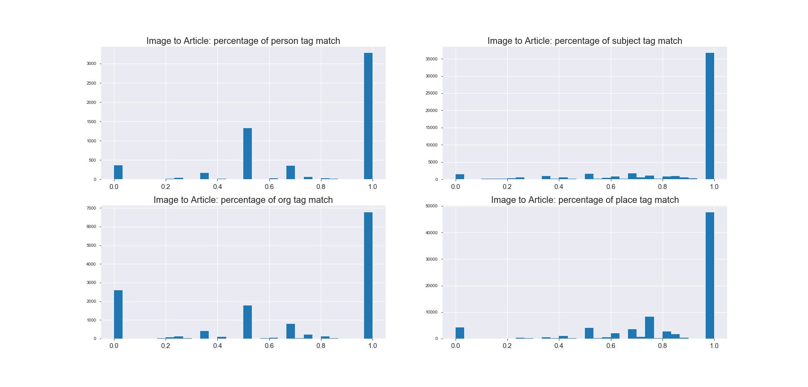
EDA: Image to Article Tag Matching

Slide 17
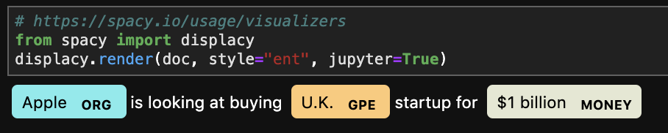
Named Entity Extraction
AP has an existing rule-based named entity extraction of text
Might have limitations on how many categories/entities to be identified
Once we have the full article text data, we plan to use spaCy to extract the named entities from the text
18 predefined categories
On the UI-side, we can potentially add a nice visualization with the highlights on named entities
For example, “Apple is looking at buying U.K. startup for $1 billion”

Slide 18
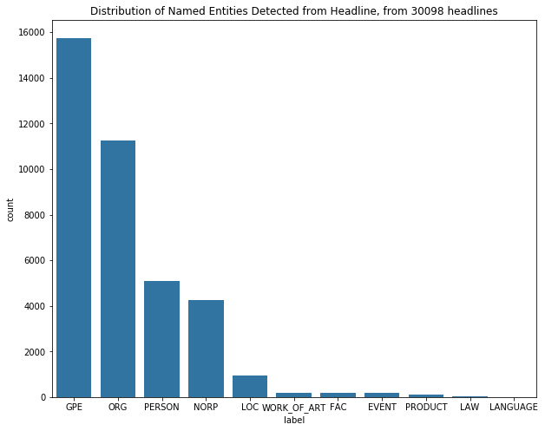
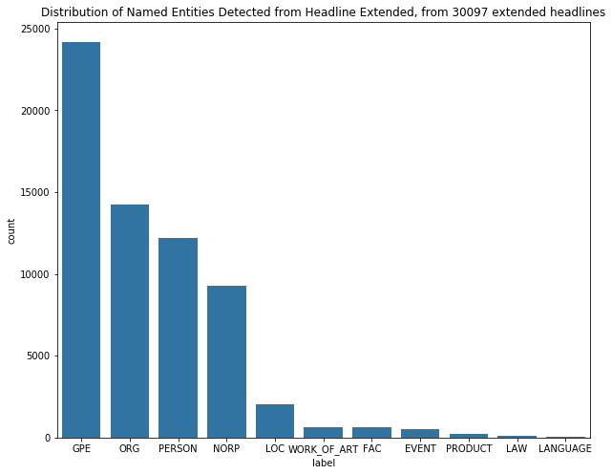
Named Entity Extraction - EDA
Using article data provided by AP, we extracted named entities from “headline” and “headline_extended”
Headline < headline_extended < description summary < full text
Most entities extracted are geographic locations
Note that “Person” are mentioned more in headline extended
Notes:
Future work includes running this on the description summary and full text
In the image recommendation task, should “person” be used more?

Slide 19
Tag-To-Tag Matching
Image 1
Tag1
Tag2
Tag3
Article 1
Image 2
Syn1
Syn2
Syn3
Tag1
Tag2
Tag3
Image 3
Tag1
INPUT
IMAGE CORPUS
models/baseline_model.py
Notes:
https://towardsdatascience.com/textrank-for-keyword-extraction-by-python-c0bae21bcec0
tf-idf

Slide 20
Baseline Model: Tag Extraction
Image
Tag1
Tag2
...
Tag3
IMAGE CORPUS
models/baseline_model.py

Slide 21
Tag-To-Tag Matching
Image 1
Tag1
Tag2
Tag3
3
Article 1
Image 2
Syn1
Syn2
Syn3
0
Tag1
Tag2
Tag3
Image 3
Tag1
1
1. Exact Matching
models/baseline_model.py
Notes:
https://towardsdatascience.com/textrank-for-keyword-extraction-by-python-c0bae21bcec0
tf-idf

Slide 22
Tag-To-Tag Matching
Image 1
Tag1
Tag2
Tag3
3
Article 1
Image 2
Syn1
Syn2
Syn3
1.5
Tag1
Tag2
Tag3
Image 3
Tag1
1
1. Exact Matching
2. Fuzzy Matching
models/baseline_model.py
Notes:
https://towardsdatascience.com/textrank-for-keyword-extraction-by-python-c0bae21bcec0
tf-idf

Slide 23
Tag-To-Tag Matching
Image 1
Tag1
Tag2
Tag3
3.4
Article 1
Image 2
Syn1
Syn2
Syn3
1.2
Tag1
Tag2
Tag3
Image 3
Tag1
0.8
1. Exact Matching
2. Fuzzy Matching
3. TF-IDF Weighted Match
models/baseline_model.py
Notes:
https://towardsdatascience.com/textrank-for-keyword-extraction-by-python-c0bae21bcec0
tf-idf

Slide 24
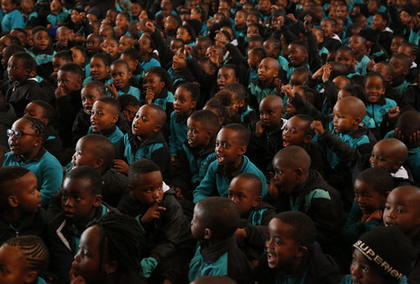
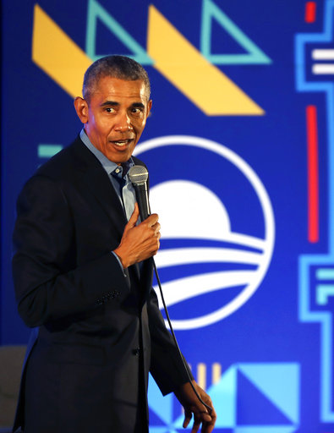
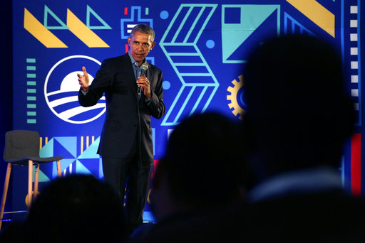
Tag-To-Tag Matching
Article Summary → Image Summary (Caption)
IMAGE | METRIC 1 | METRIC 2 | METRIC 3
 | 1 | 1 | 1
 | 3 | 3 | 3
 | 1 | 1 | 2
Notes:
https://towardsdatascience.com/textrank-for-keyword-extraction-by-python-c0bae21bcec0
tf-idf

Slide 25
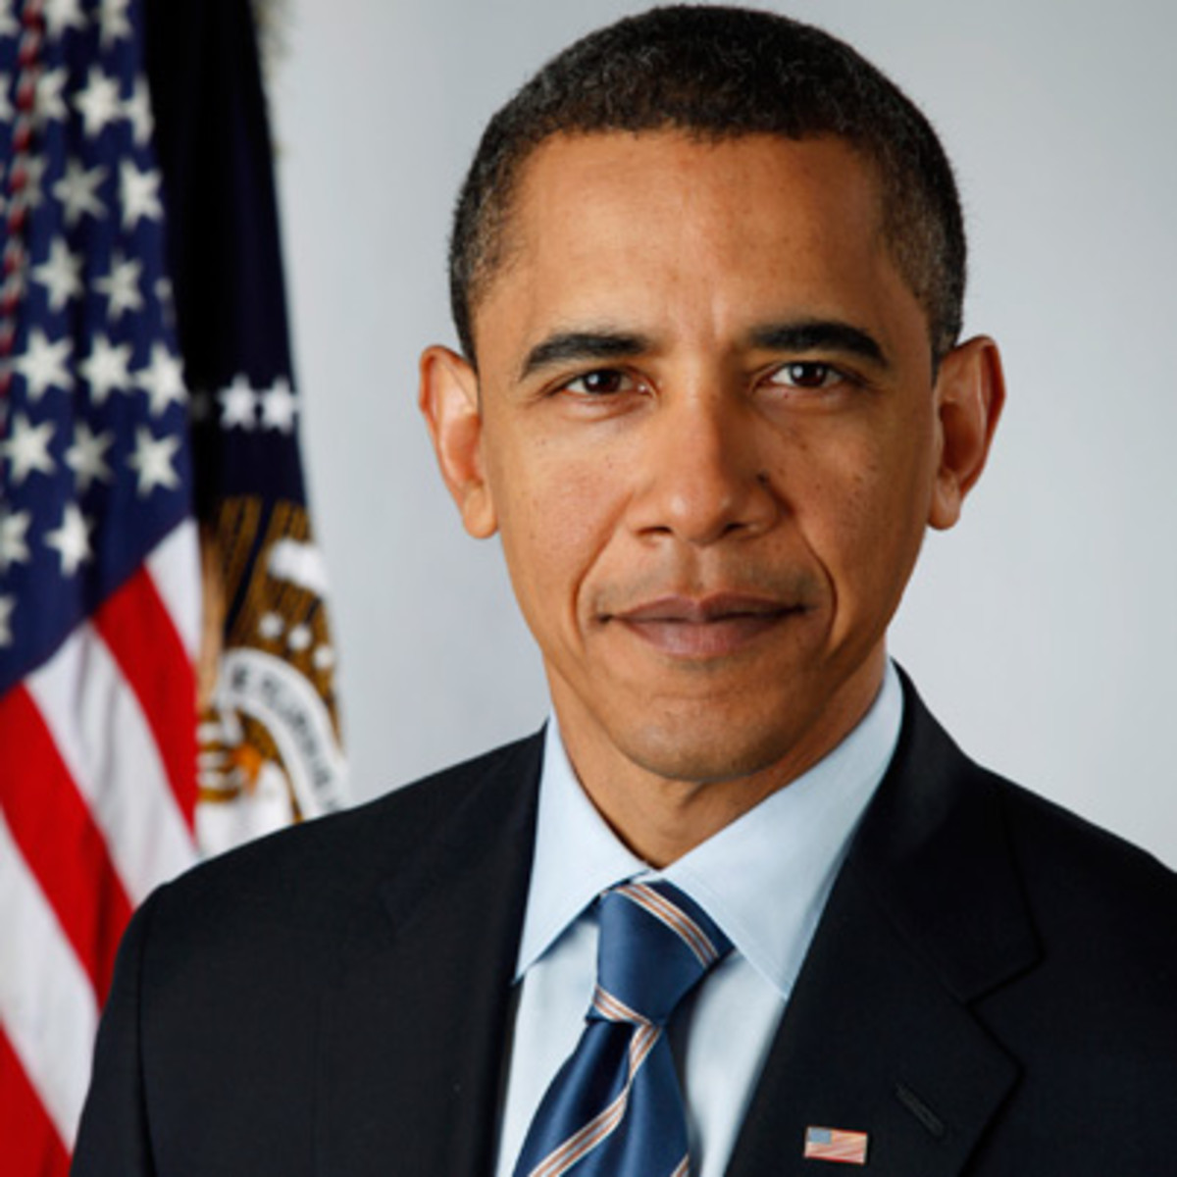
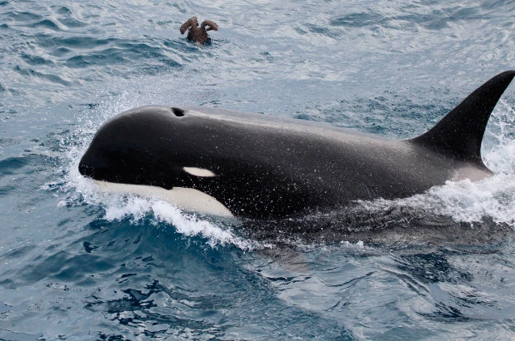
Evaluation
Challenges: Only have access to set article-image associations
Rudimentary Numeric Method
Percent of images correctly predicted by top-ten ranking
Issues: Cannot rank predictions outside given article-image associations
Need more qualitative method of evaluation
Notes:
Feature iteration

Slide 26
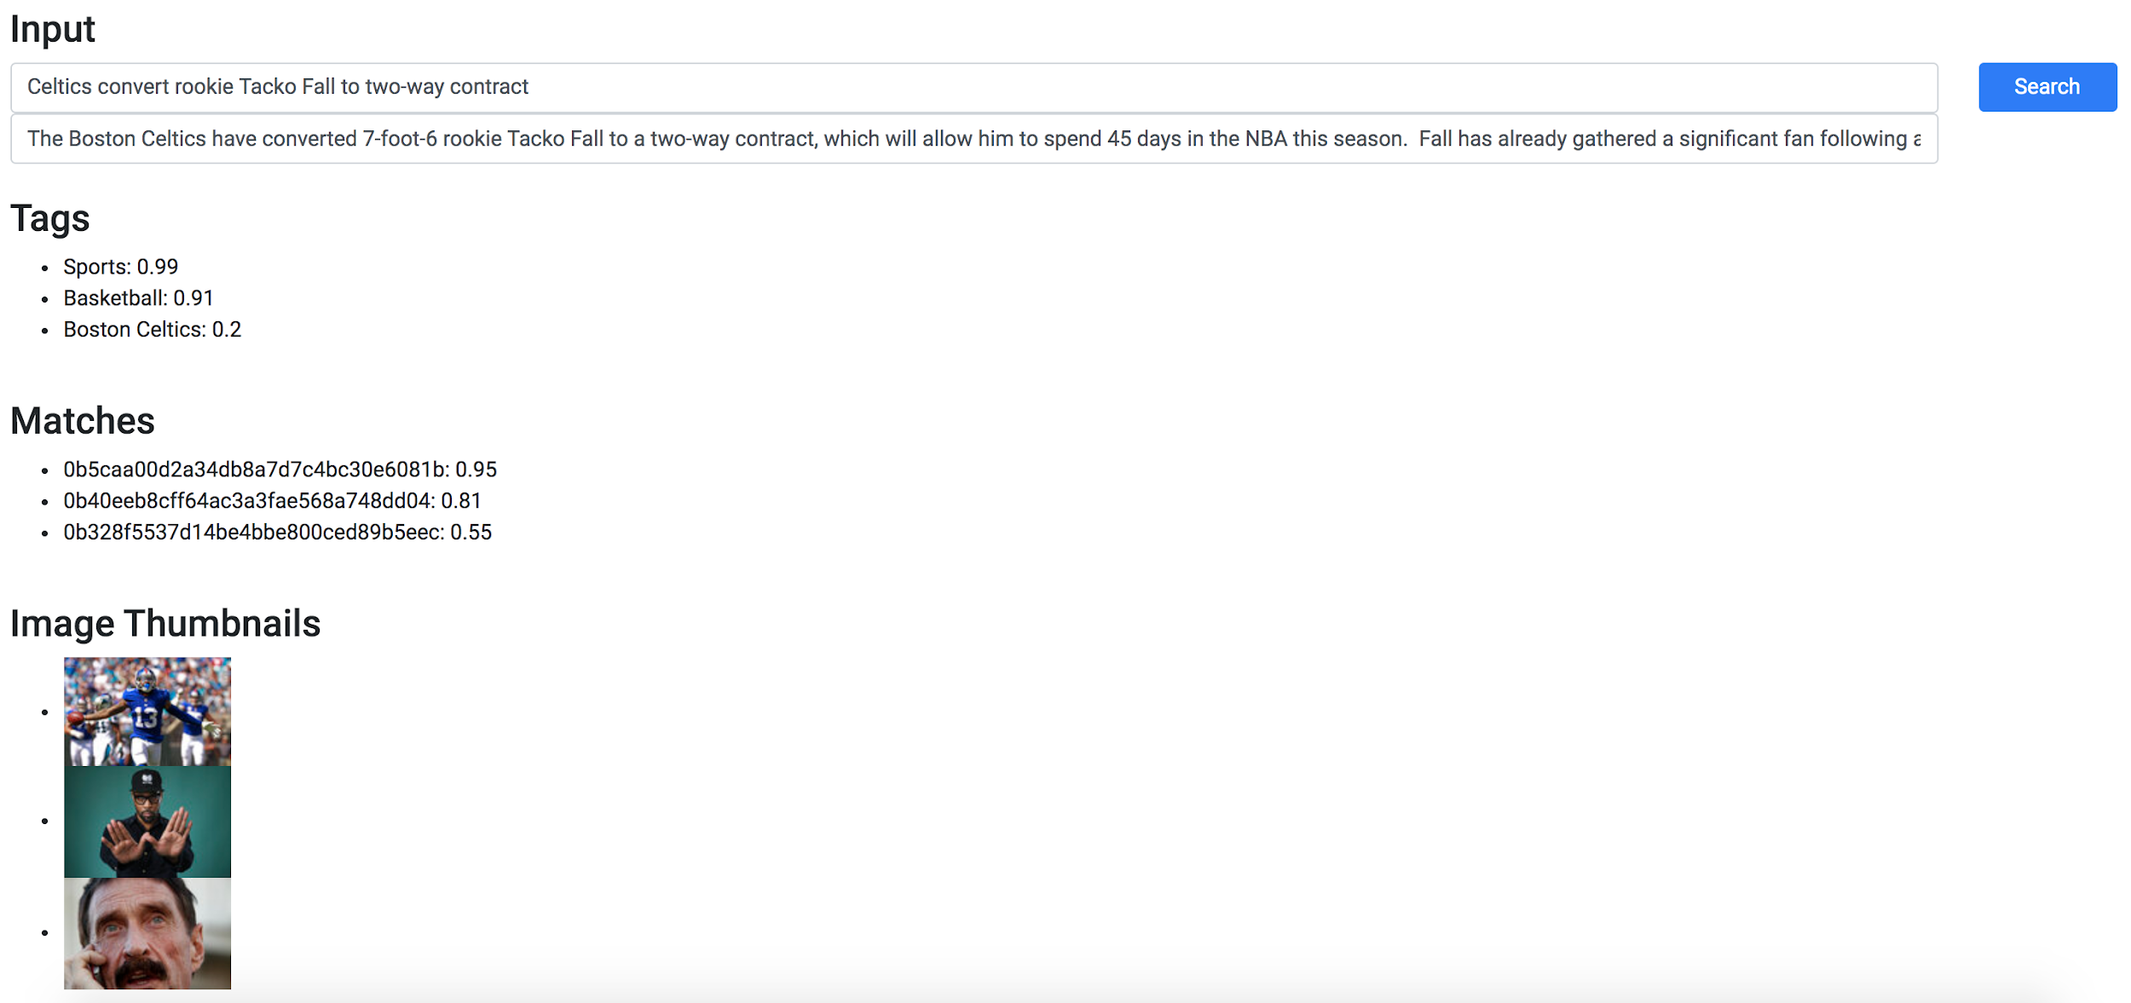
UI First Version

Slide 27
Next Steps
Oct 15 - Oct 22:
Model iteration
UI improvement
Oct 22 - Oct 29:
Model selection
UI improvement
Work with tagging API
Oct 29 - Nov 5:
Model training
Build an API wrapper for our models
Nov 5 - Nov 12:
Model training
Improve API wrapper
Nov 12 - Nov 19:
Model training
Iterate UI and API wrapper
Nov 19 - Nov 26:
Training complete
Work with AP on next steps
Nov 26 - Dec 3:
Get code base ready for shipping
Dec 3 - Dec 12:
Finalize deliverables

Slide 28
Thank You. Questions?

